Slide 1
Demographic Dividend in Africa
5th ISIbalo Young African Statisticians Conference
Research in Population and Development in Africa
St George Hotel and Conference, Pretoria, South Africa
June 13-17, 2016
Mady Biaye, PhD – Regional Technical Adviser, UNFPA ESARO Johannesburg

Slide 2
What is the Demographic Dividend?
DD is the economic benefit that can arise when a country has a relatively large proportion of working-age population due to declining fertility, and effectively invests in their health, empowerment, education and employment through public action and private sector involvement.

Slide 3
What does this mean?
Potential for economic growth
Not a given
Must not be squandered
Only becomes real if:
Necessary investments made by Government and all stakeholders, including private sector and civil society;
Population in working age empowered, healthy, well-educated and highly skilled, and employed with decent jobs.
Notes:
This potential for economic growth is not a given and must not be squandered.
It can only become real if the necessary investments have been made by the Government and all the stakeholders, including the private sector and civil society, and the population that arrives in working age is empowered, healthy, well-educated and highly skilled, and employed with decent jobs.

Slide 4
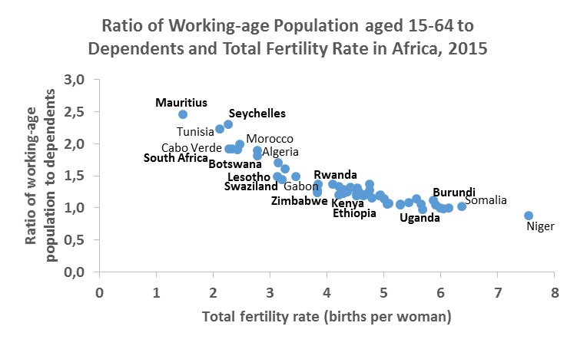
Why demographics matters?
Changing age structure can produce a window of economic opportunity in countries undergoing a fertility decline.
Notes:
The inverse of the dependency ratio, the inverse dependency ratio can be interpreted as how many independent workers have to provide for one dependent person (pension & expenditure on children).

Slide 5
Where do African countries stand regarding DD?

Slide 6
Moving from narrative and rhetoric to action
The translation of the Potential into reality assumes:
Conducive policy environment / Good governance
Healthy and skilled human capacity
Empowerment of women and young girls
Full employment
Decency of the jobs
Modern economy
The reality check of most economies in Africa informs on:
Youth potential/burden (behind the high fertility)
High unemployment rate (mostly among young people)
Real dependency among working (-age) population
Economic/Gender inequalities
Economies mostly driven by informal sector
Notes:
Graça Machel, Even It Up, Time to End Extreme Inequality, Oxfam Report:
The last decades have seen incredible human progress across Africa and the world. But this progress is under threat from the scourge of rapidly rising inequality…
Seven out of 10 people live in countries where inequality is growing fast, and those at the top of society are leaving the rest behind…
The good news is that this growing inequality is not inevitable…
Winnie Byanyima, Executive Director, Oxfam
Half of all women in sub-Saharan Africa give birth alone and in unsafe conditions.
Many of the policies that reduce economic inequality, such as free public services or a minimum wage, also reduce gender inequality.
In Africa, only six countries have so far met the Abuja commitment to allocate 15 percent of government spending to health. Between 2008 and 2012 more than half of developing countries reduced spending on education, while two-thirds decreased spending on health.

Slide 7
Africa’s demographic context
Africa’s population reached 1.2 billion in 2015 and is projected to grow rapidly, reaching 1.7 billion in 2030, 2.5 billion in 2050 and 3 billion in 2063.
Highest population growth rate: 2.4 per 100 in 2015-2020, 2.1 per 100 in 2030-2035 and 1.4 per 100 in 2060-2065.
Africa has a very young age structure of its population:
Persons under age 15 represent 40 per 100 or more of the total population in 36/54 countries in 2015 and in 15/54 countries in 2030;
Young people aged 15-24 account for 20 per 100 or more in 19/54 countries in 2015 and 27 (half of the African countries) in 2030.
Youth aged 15-34: 0.4 billion (2015), 0.99 billion (2063)

Slide 8
Research Approaches to the DD

Slide 9
DD methodological approaches in ESA region
Country assessment, Desk review | Demo-socioeconomic projections & scenarios - Comprehensive Analytical Report | DemDiv Model | National Transfer Accounting (NTA)
Ethiopia (2014), Kenya (2014), Mozambique (2014), Rwanda (2015) | Burundi (2014), Democratic Republic of Congo (2014) | Botswana (2016), Ethiopia (2014), Malawi (2015), Mozambique (2015), Swaziland (Ongoing), Tanzania (2014), Uganda (2014), Zambia (2015), Zimbabwe (Ongoing) | Kenya (2013), Mozambique (2013), South Africa (2013, 2015), Botswana (Ongoing), Swaziland (Ongoing), Zimbabwe (Ongoing)
4 countries | 2 countries | 9 countries | 6 countries
14 DD rollout countries in ESA region were provided with high quality support of which 8 have completed a DD study

Slide 10
DD modeling in the MICs where fertility is declining and is relatively low
NTA can be used to understand why DDs vary among countries and how they can be influenced by public policy.
A mixed methodology that combines NTA and DemDiv to approach better DD analysis in a context of declining and low fertility as shown by the middle income countries (MICs) in ESA region.
Collaboration needed in terms of methods through identifying and integrating the strengths of the different methods being used and assessed in order to respond better to the requirements of academic researchers and the needs of policymakers.

Slide 11
African countries at DT/DD stages

Slide 12
DD status & Actionable policy recommendations
DD Stage | Countries | Policy Priority | Recommendations
Pre-dividend Fertility levels above 4; rapid population growth, high dependency ratios, however, are expected to decline when children reach working age. | Angola, Benin, Burkina Faso, Burundi, Cameroon, Central African Republic, Chad, Comoros, Congo, Cote d’Ivoire, Democratic Republic of Congo, Equatorial Guinea, Eritrea, Gambia, Guinea, Guinea-Bissau, Liberia, Madagascar, Malawi, Mali, Mauritania, Mozambique, Niger, Nigeria, Sao Tome and Principe, Senegal, Sierra Leone, Somalia, South Sudan, Sudan, Tanzania, Togo, Uganda, Zambia | Improve human capital to reduce fertility | Improve maternal & child health Expand education Not leave girls behind Empower women Expand comprehensive FP services

Slide 13
DD status & Actionable policy recommendations
DD Stage | Countries | Policy Priority | Recommendations
Early-dividend Fertility rates fallen below 4 and the working-age share of the population is likely rising. | Algeria, Botswana, Cabo Verde, Djibouti, Egypt, Ethiopia, Gabon, Ghana, Kenya, Lesotho, Libya, Namibia, Rwanda, South Africa, Swaziland, Zimbabwe | Accelerate job creation Create productive jobs for the growing share of the population in working age to reap the first DD | Invest in human capital, including technical and vocational education and training (TVET) Reduce barriers to female labor force participation (LFP) Strengthen conditions conducive to savings and job creation

Slide 14
DD status & Actionable policy recommendations
DD Stage | Countries | Policy Priority | Recommendations
Late-dividend Fertility rates are typically above replacement levels of 2.1, but fertility continues to decline. Even though they have shrinking working-age shares, their overall age structures are still favorable for the first DD. | Mauritius, Morocco, Seychelles, Tunisia | Sustain productivity growth Create conditions necessary to reap the second DD Prepare for aging | Continue mobilization of savings for productive investment Ensure that public policies encourage LFP for both sexes Design cost-effective systems for welfare vulnerable elderly

Slide 15
Demographic Window of Opportunity for Harnessing DD in African Countries
Demographic Window of Opportunity

Slide 16

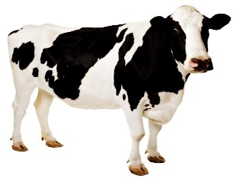


Actually, there is no choice…
+ Demographic Trans.
- Investment in Youth
(Status quo – no social return)
+Production
+ Demographic Trans.
+ Investment in Youth
(Best case)
Harness DD and SDG
Half loaf is better than nothing!
And at your own risk!
Milk & Honey
-Welfare
+Welfare
-Production
Every one for himself and God for us all.
- Demographic Trans.
- Investment in Youth
(Worst case)
Miss both
DD and SDG
Staggering
- Demographic Trans.
+ Investment in Youth
(Status quo – no social return)
Notes:
Cow: Milk and Honey
Chameleon: Staggering
Hyena: Every one for himself and God for us all
Butterfly: Half loaf is better than nothing
Les gouvernements ne peuvent pas autant manquer de vision pour ne pas veiller à l’ éducation de la jeune fille et à l’autonomisation de la femme et ainsi prévenir qu’ils ne peuvent pas continuer à s’écrouler sous le poids des charges sociales, accentuées par les besoins de plus en plus croissante de la jeunesse…
Ils ne peuvent pas être aussi ingrats pour oublier la jeunesse qui les a hissé au perchoir de la prise de décision politique pour que celle-ci soit tronquée…
Ils ne sont pas non plus aussi suicidaires pour ignorer tout sous un dictat de politique politicienne dans une jungle ou ils seront naturellement les premiers à en pâtir et sans espoir de survie.
Aujourd’hui la politique est de plus en plus mieux éclairée dans la conscience citoyenne pour comprendre qu’il n’y a pas ici plus d’un terme d’un choix pour une tête lucide.

Slide 17
Equation of success
Economic growth
+
Family planning
+
Social policies (H3E)
+
Sustainable Env.
Achieved SDGs
+
Harness DD
+
Improved Welfare
+
Sustainable future
=

Slide 18
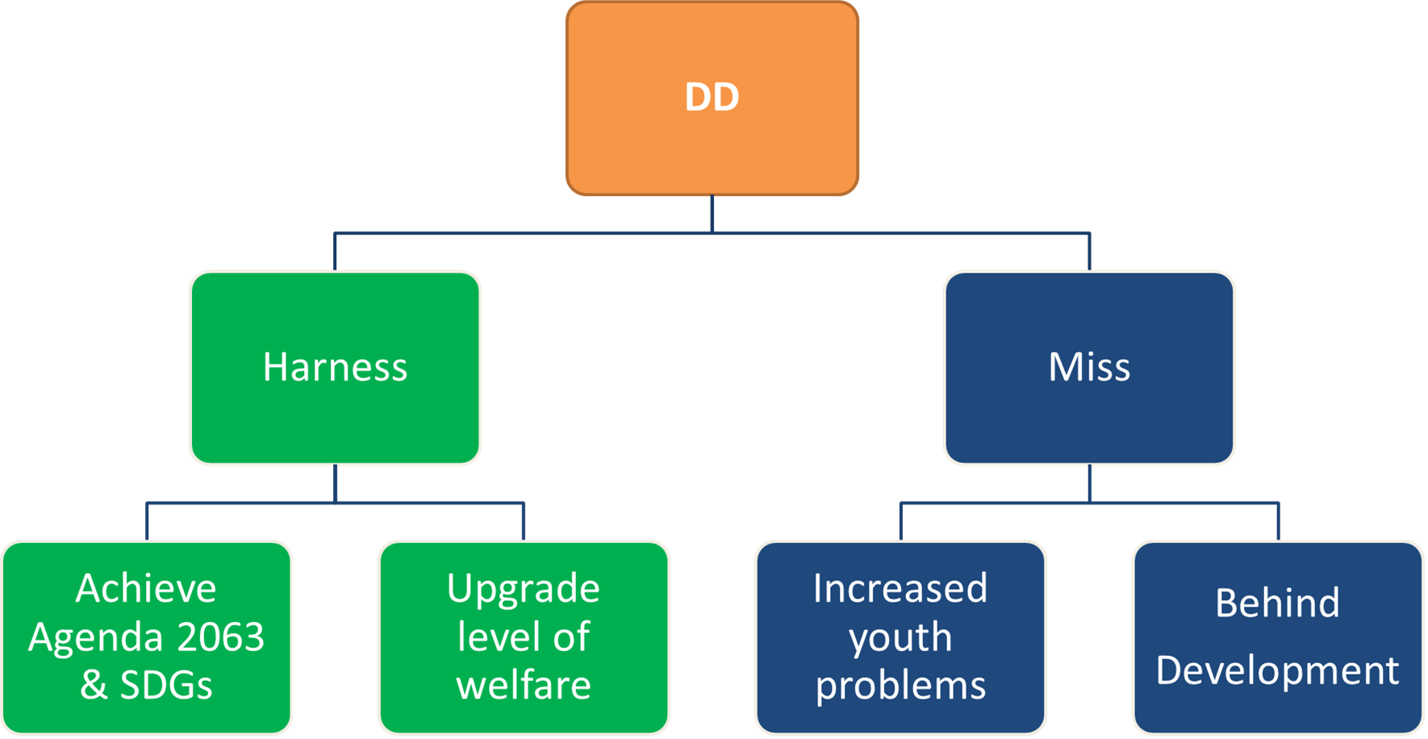
Advanced Africa & Achieved potential vs. Underdeveloped Africa & Risk of conflict

Slide 19
Agenda 2063 is not a fiction but a mobilizing conquering dream!
Notes:
A mobilizing conquering dream that is to be expressively matured in the achievement of the expected transformational outcomes of the successive Ten Year Implementation Plans of the African Agenda 2063.
For its success, the implementation of the African Agenda 2063 must transcend the political terms and borders.

Slide 20
DD Assessment, Planning, Programming and Implementation Processes
Data & Evidence Generation
National Population Policy
Vision
Summary
Advocacy & Policy Dialogue
Population Projections
Action Plan
Resource
Allocation &
Mobilization
Thematic Mapping & Sub-Analysis
Project
Costing
NTA
Situation Analysis
Long-term Planning & Visioning
Financing & Implementing
DemDiv
Comprehensive
Poverty & Inequality mapping & Sub-Analysis
Budgeting
Demo-economic Projections
SDG-based Development Frameworks
& Integration
Implementation
Monitoring & Evaluation
Scenarios
Roadmap
Building Regional, National & Local Capacities
National Ownership, Commitment & Leadership
Inclusiveness &
Sustainability

Slide 21
Thank you.

